Slide 1
Lambda Integrating with airflow
Lambda : AWS Lambda is a serverless, event-driven compute service that lets you run code for virtually any type of application or backend service without provisioning or managing servers. You can trigger Lambda from over 200 AWS services and software as a service (SaaS) applications, and only pay for what you use.
Airflow : Airflow is used for scheduling, authoring and monitoring the workflows.
airflow.providers.amazon.aws.operators.lambda_function — apache-airflow-providers-amazon Documentation

Slide 2
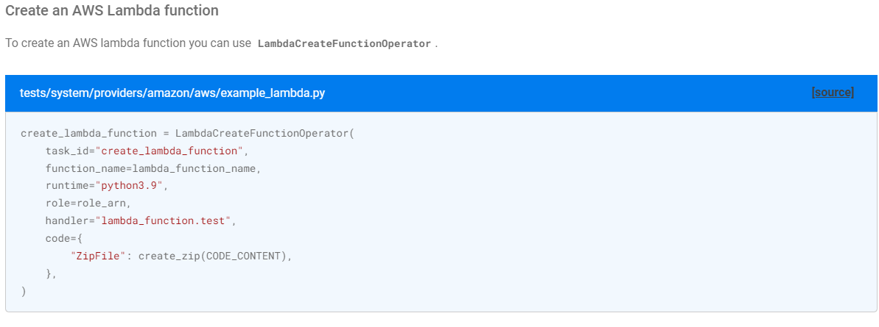

Slide 3
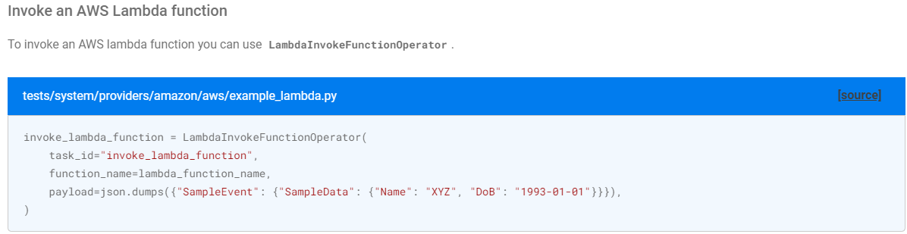
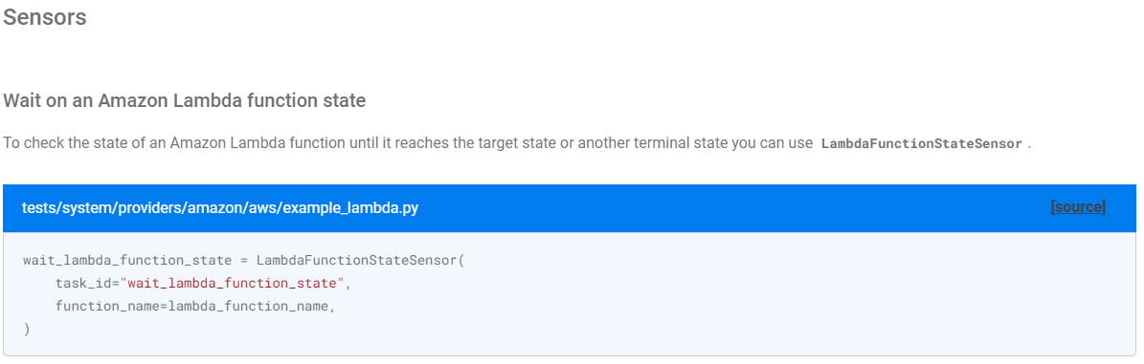

Slide 4
with DAG(
'invoke_lambda_dag',
default_args=default_args,
schedule_interval=None, # Set the schedule_interval as needed
catchup=False,
) as dag:
# Define the payload for the Lambda function
payload = {
"key1": "value1",
"key2": "value2"
}
# Create the AwsLambdaInvokeFunctionOperator task
invoke_lambda_task = AwsLambdaInvokeFunctionOperator(
task_id='invoke_lambda_task',
function_name='YourLambdaFunctionName', # Replace with your Lambda function name
payload=payload,
aws_conn_id='aws_default', # Specify your AWS connection ID
log_invoke_payload=True,
)
# Define task dependencies
invoke_lambda_task
from airflow import DAG
from airflow.providers.amazon.aws.operators.aws_lambda import AwsLambdaInvokeFunctionOperator
from datetime import datetime
default_args = {
'owner': 'airflow',
'start_date': datetime(2023, 8, 7),
'depends_on_past': False,
'email_on_failure': False,
'email_on_retry': False,
'retries': 1,
}

Slide 5
EMR serverless integrating with airflow
EMR serverless : Amazon EMR Serverless is a new deployment option for Amazon EMR. EMR Serverless provides a serverless runtime environment that simplifies the operation of analytics applications that use the latest open-source frameworks, such as Apache Spark and Apache Hive. With EMR Serverless, you don’t have to configure, optimize, secure, or operate clusters to run applications with these frameworks.
https://airflow.apache.org/docs/apache-airflow-providers-amazon/stable/operators/emr/emr_serverless.html
https://docs.aws.amazon.com/emr/latest/EMR-Serverless-UserGuide/using-airflow.html

Slide 6
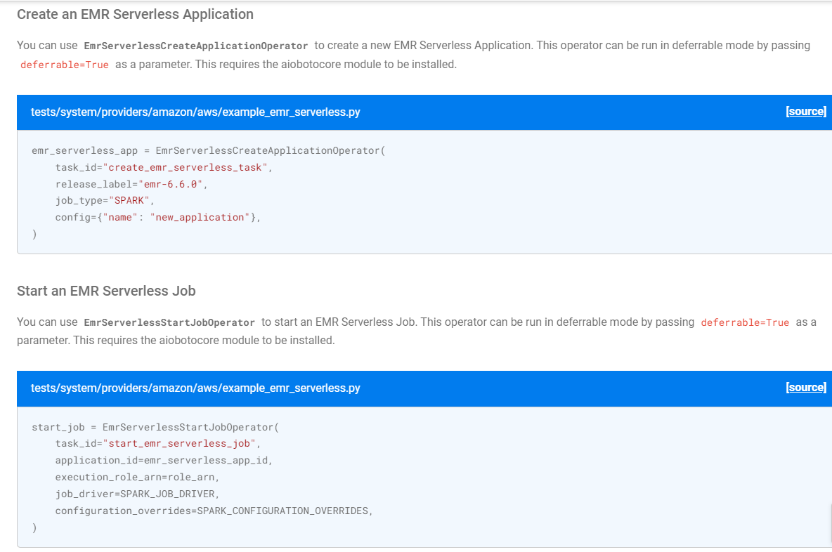
Operators

Slide 7
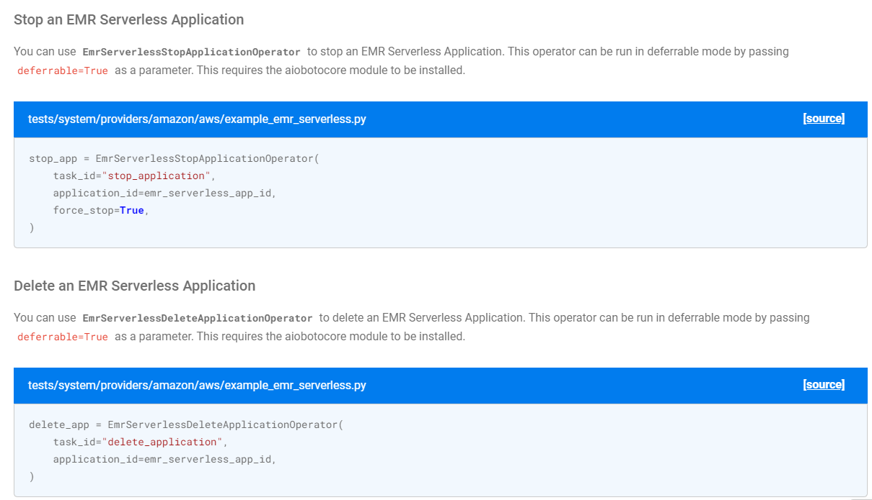

Slide 8
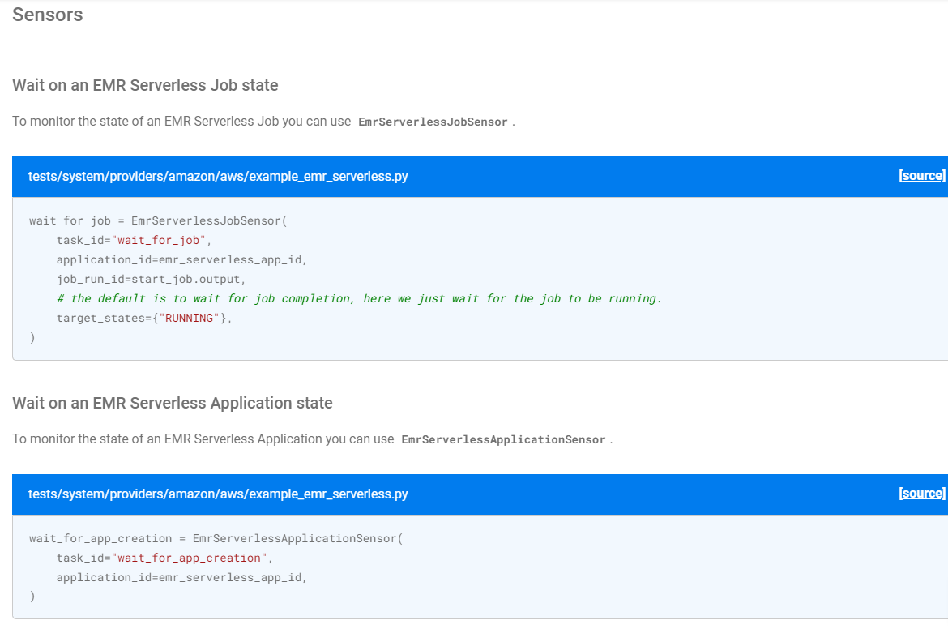

Slide 9
EMR integration with airflow
Amazon EMR (previously called Amazon Elastic MapReduce) is a managed cluster platform that simplifies running big data frameworks, such as Apache Hadoop and Apache Spark, on AWS to process and analyze vast amounts of data. Using these frameworks and related open-source projects, you can process data for analytics purposes and business intelligence workloads. Amazon EMR also lets you transform and move large amounts of data into and out of other AWS data stores and databases, such as Amazon Simple Storage Service (Amazon S3) and Amazon DynamoDB.
https://airflow.apache.org/docs/apache-airflow-providers-amazon/stable/operators/emr/emr.html

Slide 10
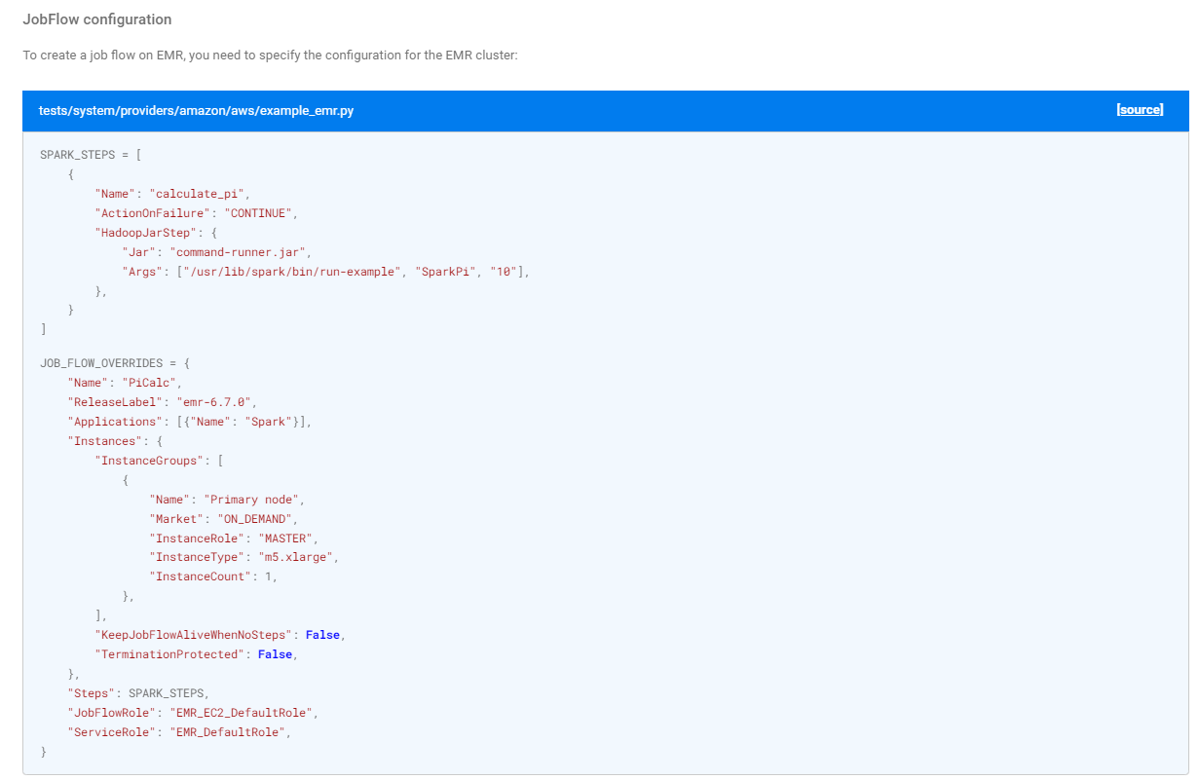

Slide 11
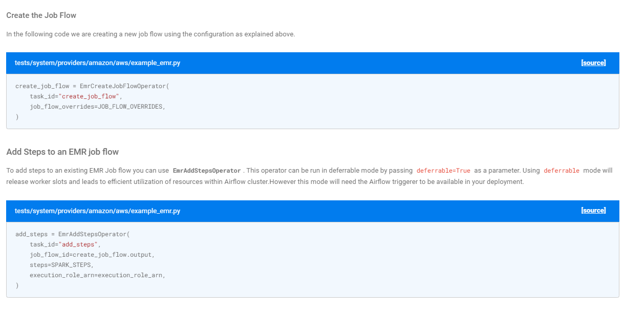

Slide 12
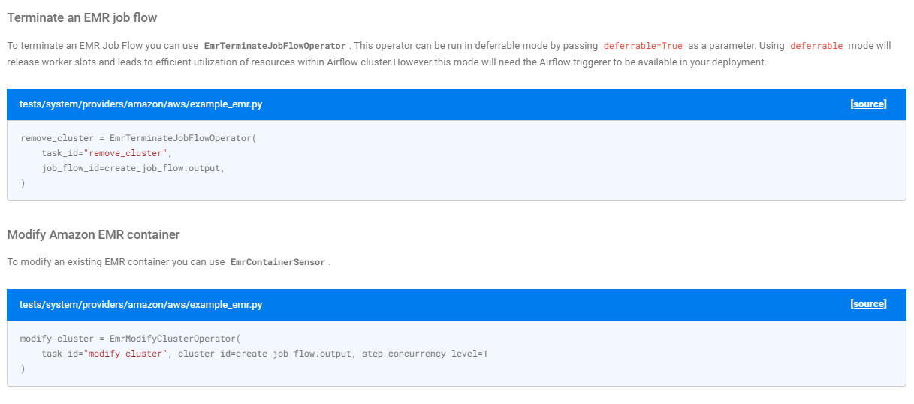

Slide 13
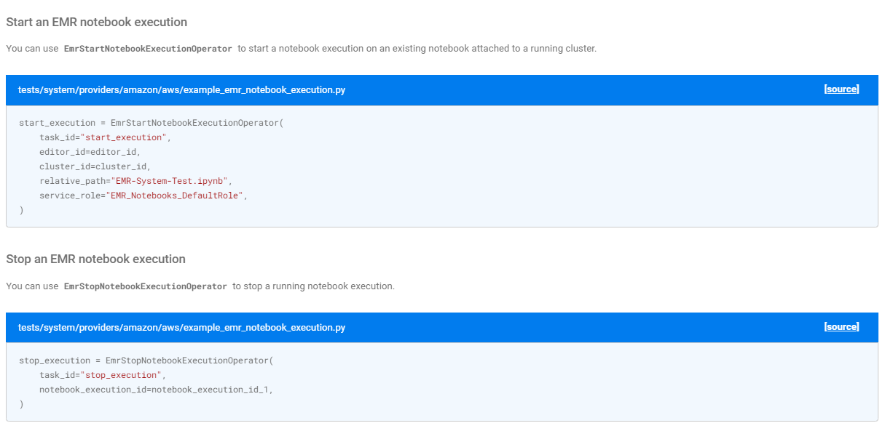

Slide 14
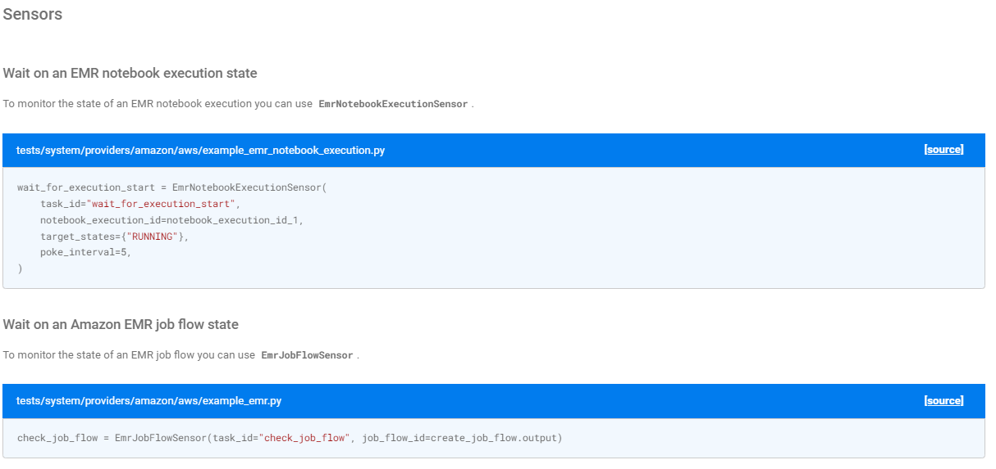

Slide 15
